Slide 1
Gate Level Minimization
Chapter 3
Hammad Afzal
hammad.afzal@mcs.edu.pk
Computer Science Department
College of Telecommunication Engineering
National University of Sciences and Technology

Slide 2
The Universal Gates
NAND
NOR
Universal gate because they can be used to implement any logic gate

Slide 3
NAND Gate
AND-Invert
F = (xyz)’
Invert-OR
F = x’+y’+z’

Slide 4
NOR Gate
OR-Invert
F = (x+y+z)’
Invert-AND
F = x’y’z’

Slide 5
NOT Gate
AND-Invert
OR-Invert
Buffer-Invert

Slide 6
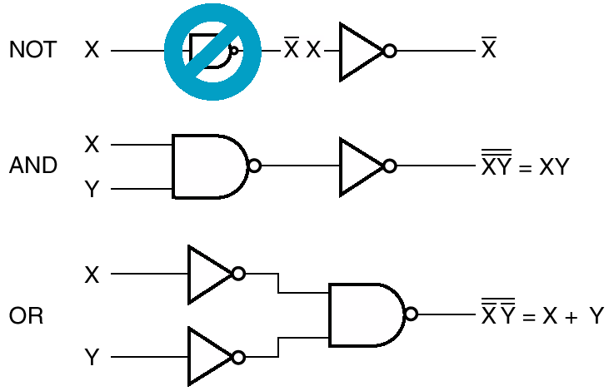
NAND Implementation

Slide 7
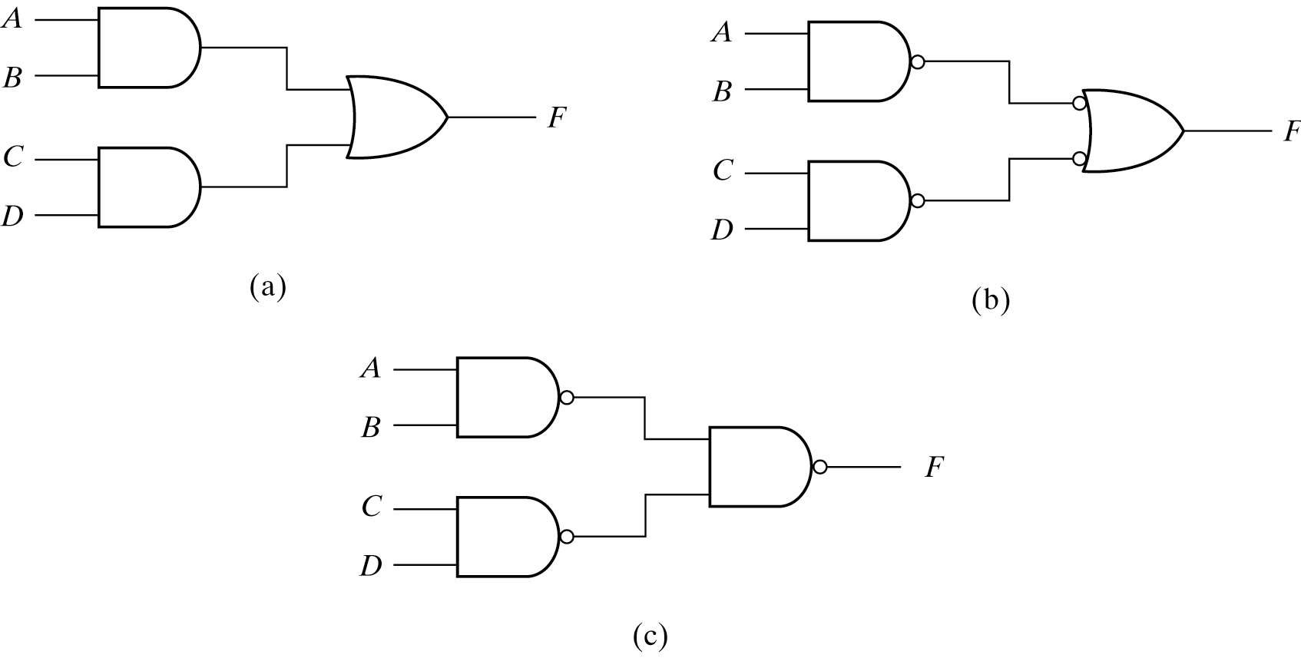
Two-Level NAND Implementation
Example: F = AB+CD
Three ways to implement F=AB+CD

Slide 8
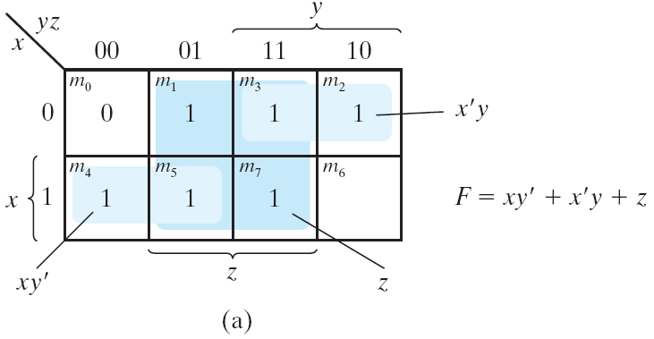
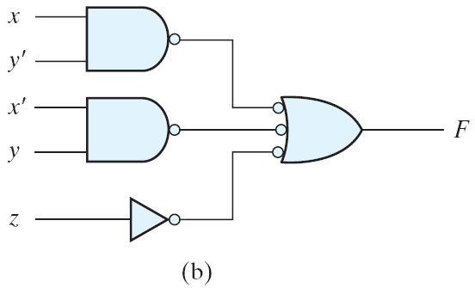
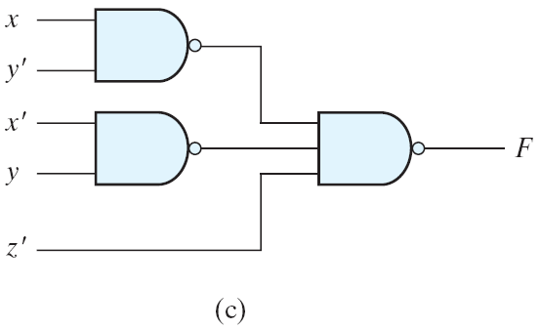
Two-Level NAND Implementation

Slide 9
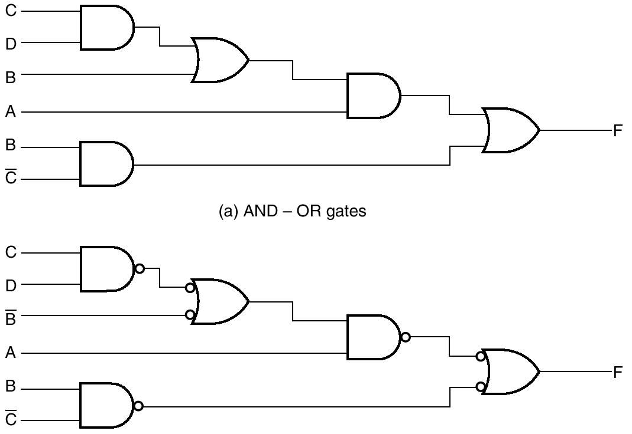
Multilevel NAND Circuits
Implementing F = A(CD + B) + BC′
Bubbles cancel each other
Note this complement

Slide 10
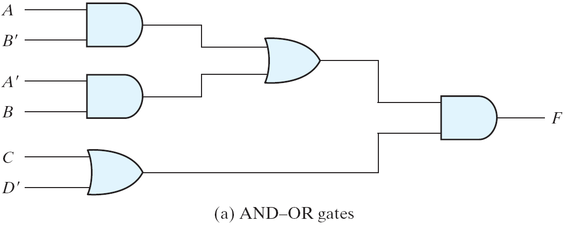
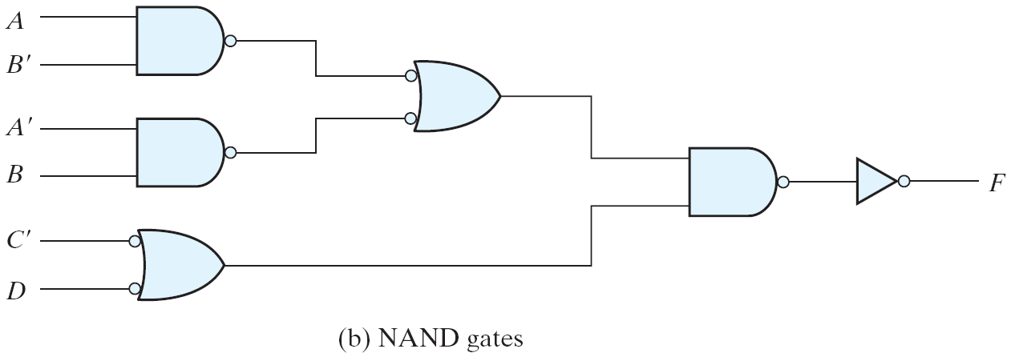
Multilevel NAND Circuits
Implementing F = (AB′ +A′B)(C+ D′)

Slide 11

NAND Circuits – General Procedure
Convert all AND gates to NAND gates with AND-NOT graphic symbols
Convert all OR gates to NAND gates with NOT-OR graphic symbols
Check all the bubbles in the diagram
Every bubble that is not compensated by another along the same line will require the insertion of an inverter or complement the input literal

Slide 12
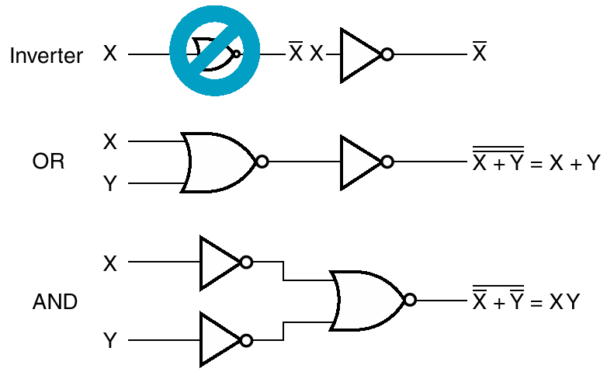
NOR Implementation

Slide 13
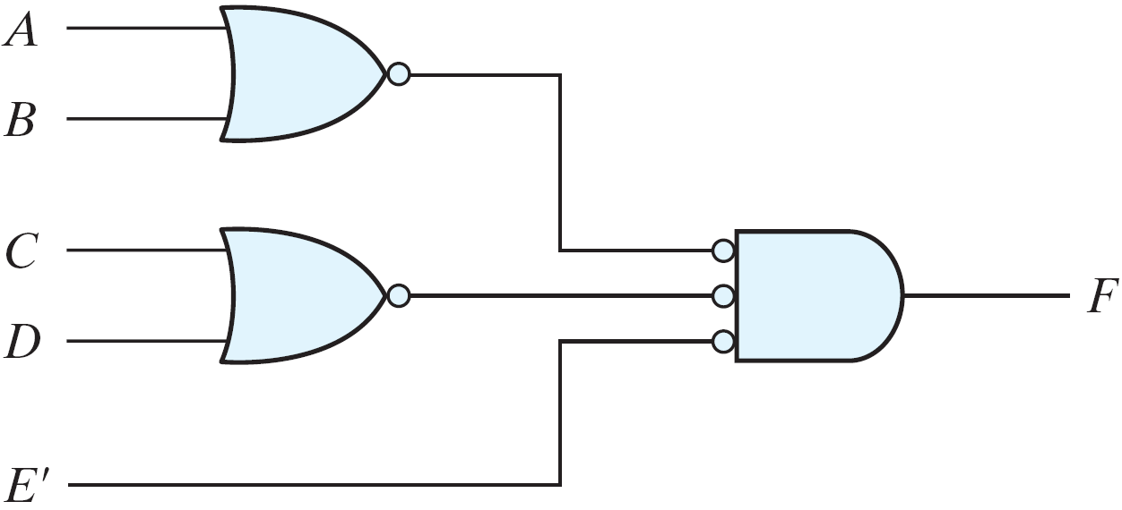
Two-Level NOR Implementation
Implementing F = (A + B)(C + D)E

Slide 14
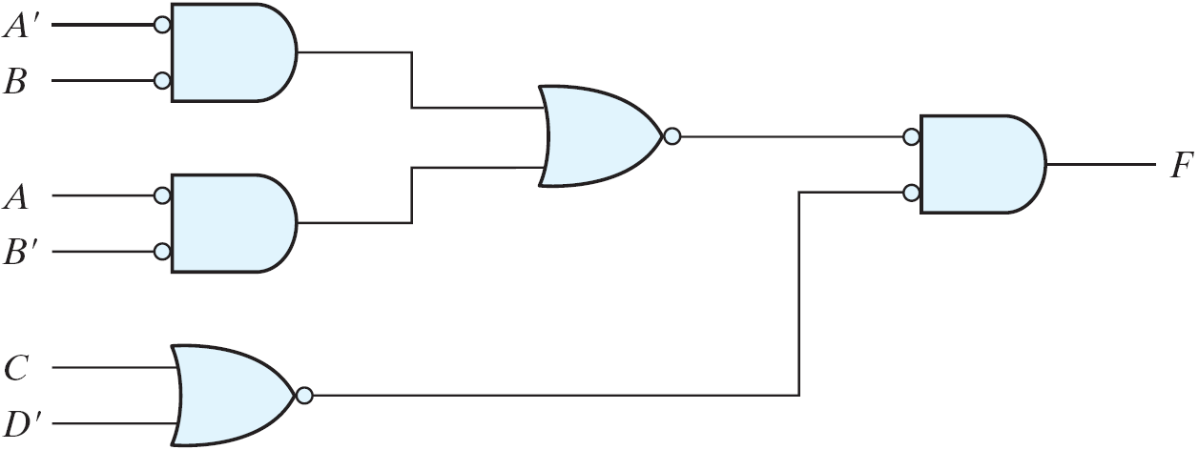
Multilevel NOR Circuit
Implementing F = (AB′ +A′B)(C + D′)

Slide 15
NAND/NOR Summary
Given a function, if you are asked to implement it with
NAND Gates ONLY
Simplify the function to Sum of Products form
Implement it using two level AND-OR circuit
Convert the AND-OR to NAND-NAND circuit
NOR Gates ONLY
Simplify the function to Product of Sums
Implement it using two level OR-AND circuit
Covert OR-AND to NOR-NOR circuit

Slide 16
Degenerate & Non-Degenerate Forms
Consider 4 types of gates: AND, OR, NAND and NOR
There are 16 different configurations of 2-level implementation.
8 are said to be degenerate forms because they degenerate to a single operation.
8 are non-degenerate forms because they produce an implementation in sum of products or product of sums

Slide 17
Degenerate Forms
Reduce to a single operation
AND-AND ==> AND
AND-NAND ==> NAND
OR-OR ==> OR
OR-NOR ==> NOR
NAND-OR ==> AND-NAND ==> NAND
NAND-NOR ==> AND-AND ==> AND
NOR-AND ==> OR-NOR ==> NOR
NOR-NAND ==> OR-OR ==> OR

Slide 18
Degenerate Froms
Example – NAND-NOR
F=((ab)’+(cd)’+e)’
F=abcde’

Slide 19
Non-Degenerate Forms
AND-OR ✓ | OR-AND ✓
NAND-NAND ✓ | NOR-NOR ✓
NOR-OR | NAND-AND
OR-NAND | AND-NOR

Slide 20
Non-Degenerate Forms
Sum of Products
Product of Sums
AND-OR ✓ | OR-AND ✓
NAND-NAND ✓ | NOR-NOR ✓
NOR-OR | NAND-AND
OR-NAND | AND-NOR

Slide 21
Non-Degenerate Forms
AND-OR ✓ | OR-AND ✓
NAND-NAND ✓ | NOR-NOR ✓
NOR-OR | NAND-AND
OR-NAND | AND-NOR
OR-AND-INVERT
AND-OR-INVERT

Slide 22
AND-OR-INVERT
AND-NOR
NAND-AND
AND-NOR
AND-NOR
NAND-AND

Slide 23
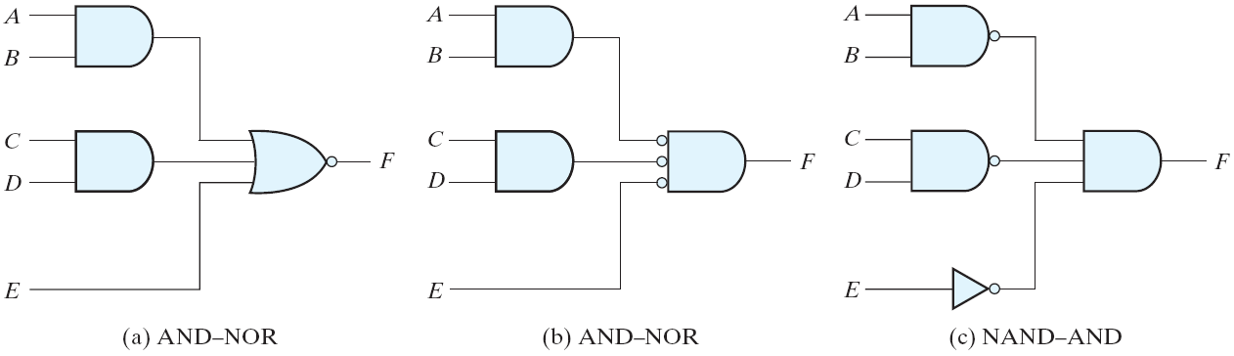
AND-OR-INVERT
F = (AB +CD +E)′

Slide 24
OR-AND-INVERT
OR-NAND
NOR-OR
OR-NAND
OR-NAND
NOR-OR

Slide 25
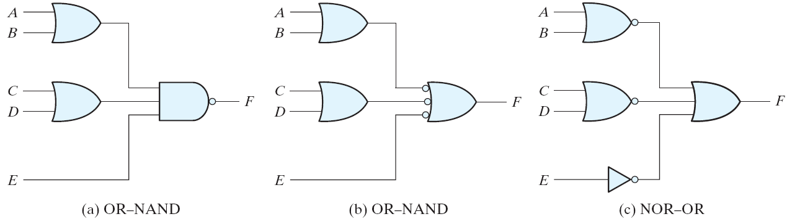
OR-AND-INVERT
F = ((A+B)(C+D)E)'

Slide 26
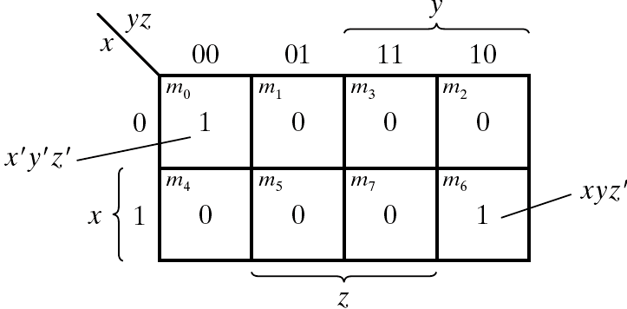
Example
Implement with AOI & OAI

Slide 27

Example
For AOI
Simplify into Sum of Products by combining 0s

Slide 28
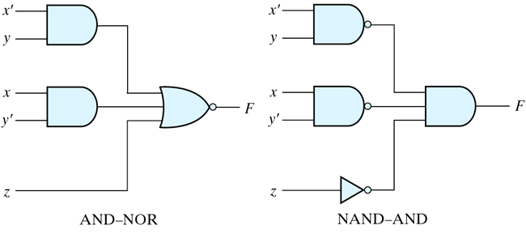
Example
For AOI
Simplify into Sum of Products by combining 0s

Slide 29
Example
For OAI
Combine 1s in the map
Take its complement to get Product of Sums
Get the function F by complementing the above

Slide 30
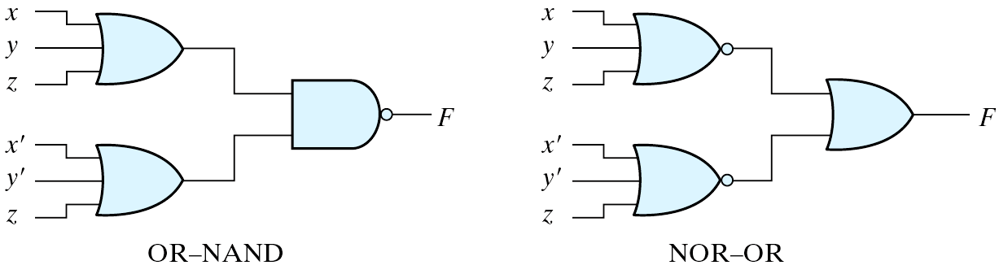
Example
OAI

Slide 31
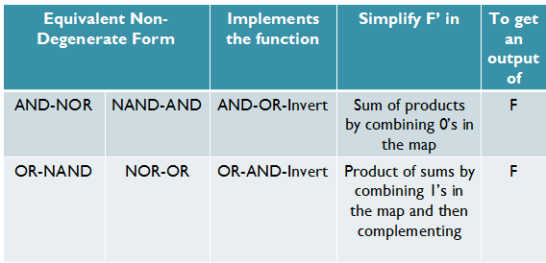
AOI & OAI - Rules

Slide 32
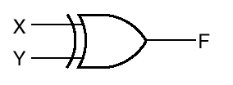


Exclusive-OR Function
Exclusive-OR (XOR) performs the following function
x ⊕ y = xy’ + x’y
This function is equal to one only if either x or y is equal to one but not both

Slide 33
Exclusive-OR Functions
Exclusive NOR (XNOR) can be generated by taking the complement of an XOR operation
(x ⊕ y)’ = xy + x’y’
The following identities apply to XOR
x ⊕ 0 = x
x ⊕ 1 = x’
x ⊕ x = 0
x ⊕ x’ = 1
XOR is also commutative and associative

Slide 34
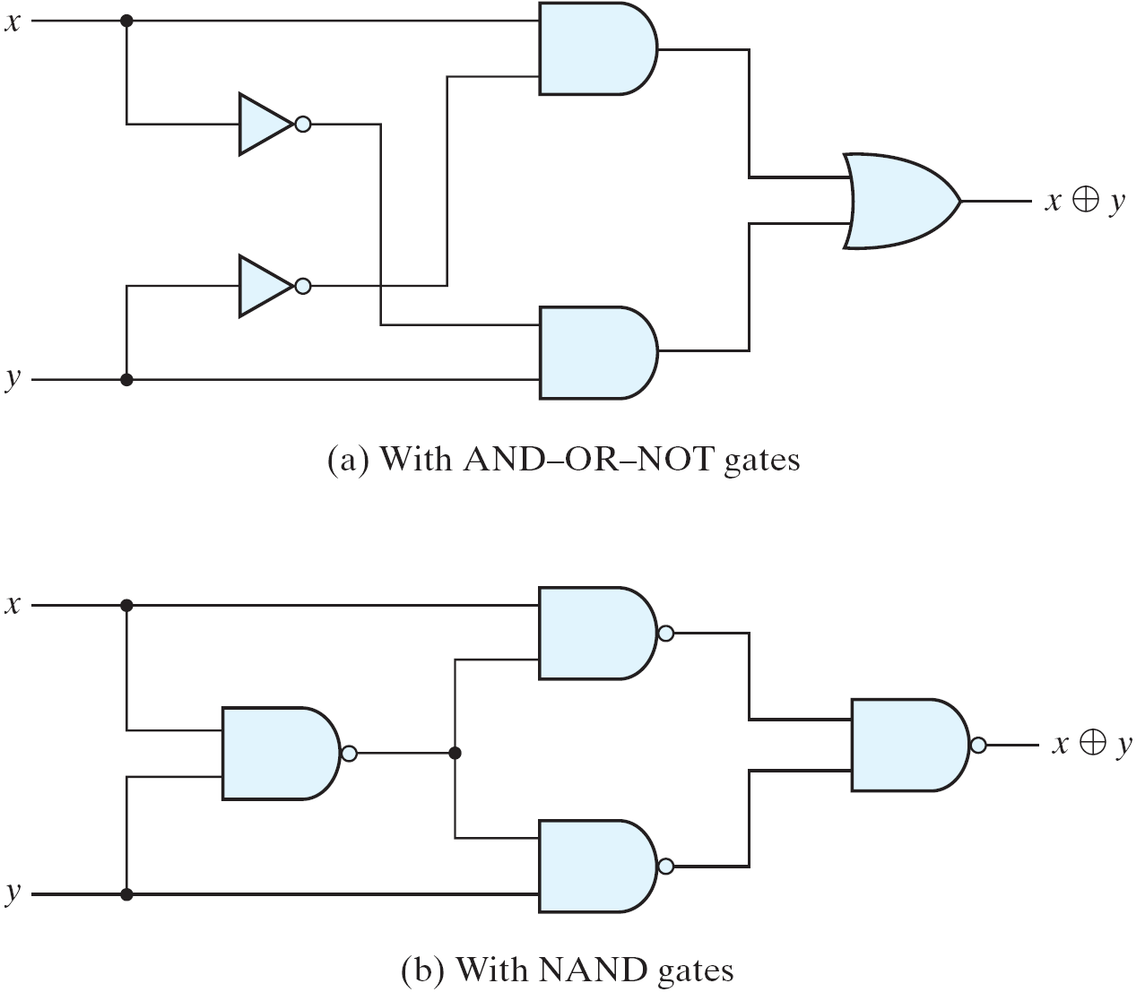
XOR Implementations

Slide 35
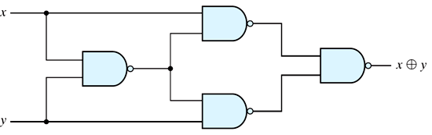
XOR Implementations
(x.(xy)’)’
((x.(xy)’)’ . (y.(xy)’)’)’
(xy)’
(y.(xy)’)’
F=((x.(xy)’)’ . (y.(xy)’)’)’
F= x.(xy)’ + y.(xy)’
F= x.(x’+y’) + y.(x’+y’)
F= x.x’+x.y’ + x’.y+y.y’
F=xy’+x’y

Slide 36
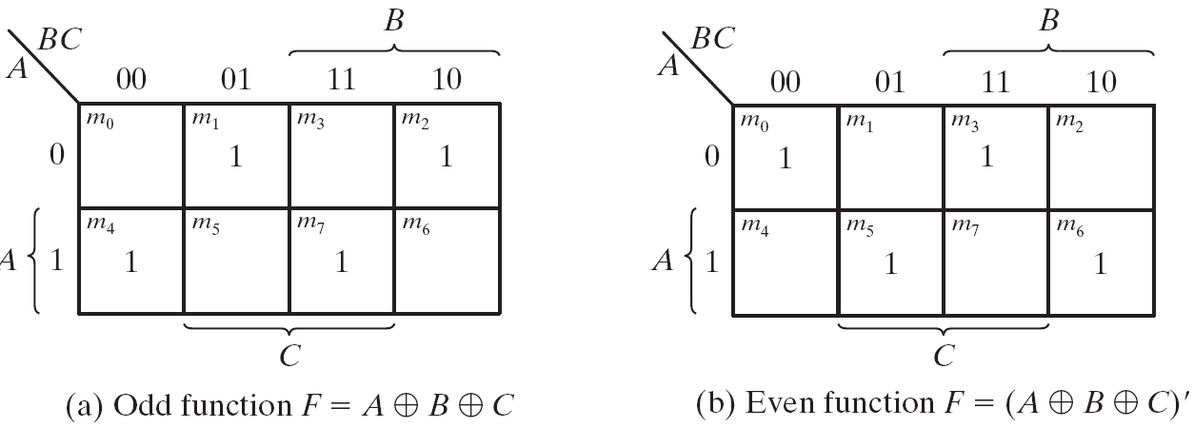
Odd Function
A⊕B⊕C = (AB'+A'B)C' +(AB+A'B')C = AB'C'+A'BC'+ABC+A'B'C = Σ(1, 2, 4, 7)
XOR is a odd function → an odd number of 1's, then F = 1.
XNOR is a even function → an even number of 1's, then F = 1.

Slide 37
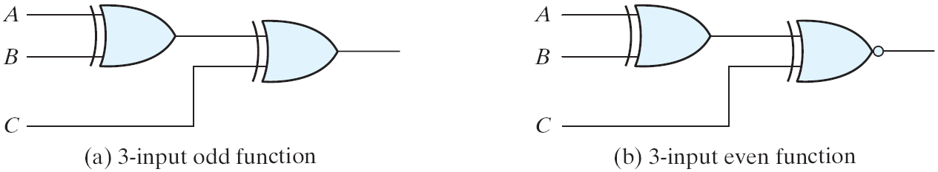
XOR & XNOR
Logic diagrams of odd and even functions
Logic Diagrams of Odd and Even Functions

Slide 38
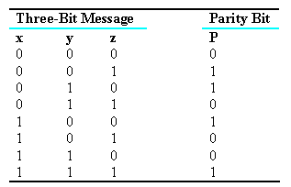
Parity Generation & Checking
XOR functions are very useful in systems requiring error-detection and correction codes.
A circuit that generates a parity bit is called a parity generator.
The circuit that checks the parity is called a parity checker.
Even Parity

Slide 39
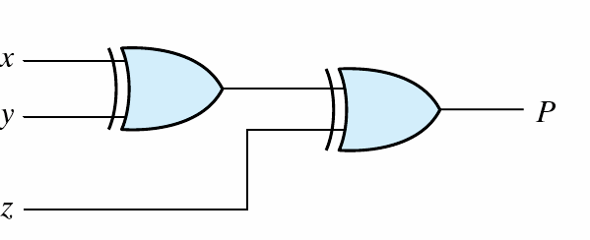
Parity Generator
A parity bit: P = x⊕y⊕z
X
Y
Z
P
3-bit even parity generator

Slide 40
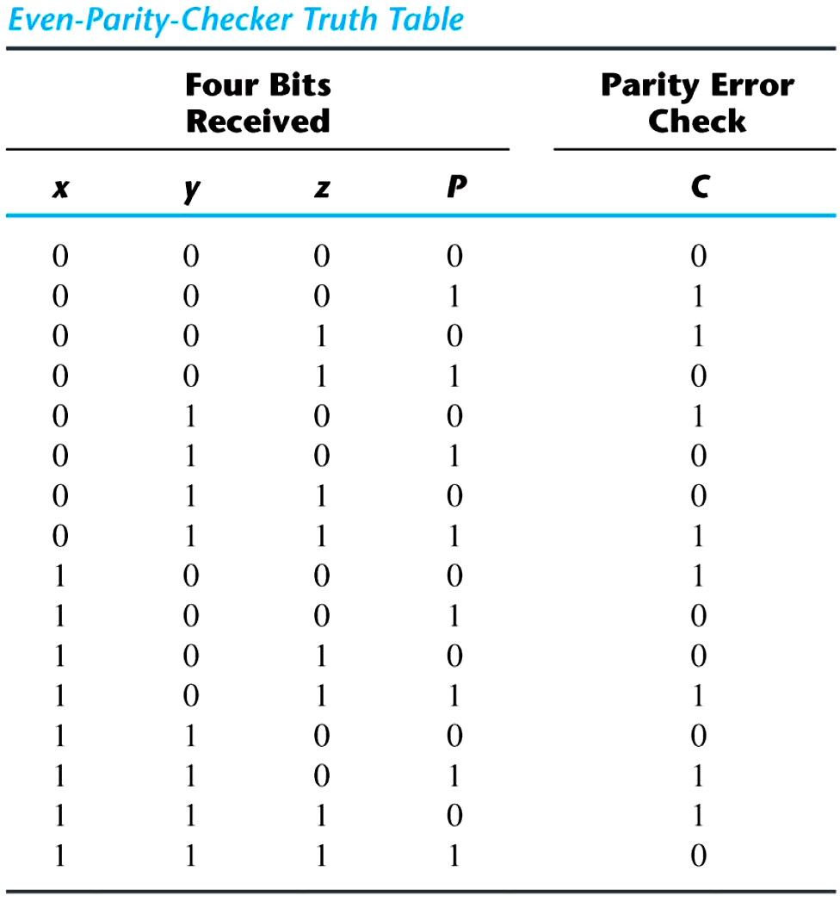
Parity Checker
Parity check:
C = x⊕y⊕z⊕P
C=1: one bit error or an odd number of data bit error
C=0: correct or an even # of data bit error

Slide 41
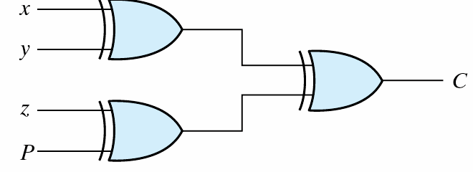
Parity Checker
Parity check: C = x⊕y⊕z⊕P
C=1: one bit error or an odd number of data bit error
C=0: correct or an even # of data bit error
Parity checker

Slide 42
References
Chapter 3 – Digital Design Morris Mano
Material in these slides has been taken from, the following resources

